Slide 1


Measures of Relative Standing
AC52012: Research Methods
Notes:
In this video we’re going to look at ‘measures of relative standing’ – I’ll explain what these are, how they’re different from measures of centre, important examples of these measures, and of course how they can be applied to an understanding of our data.

Slide 2
DESCRIPTIVE STATISTICS
Summarise (describe) our data in a meaningful way (numerically + visually)
Measures of…
- central tendency
- spread
- distribution
Tells us everything about our data
Can’t draw conclusions beyond that data
Notes:
These measures are another instance of descriptive statistics, which as a reminder, are the measures we can use to summarise and describe our data, but not infer anything bigger about the population from it.

Slide 3
WHAT IS A ‘MEASURE OF CENTRE’?
A value at the centre (or middle) of a data set
Used to summarise a data set with one value. Including…
Mean
Mode
Median
Midrange
Notes:
In the previous video, we looked at measures of centre, AND at measures of variation. While the latter can give us a number that represents how spread out our data is, they don’t allow us to take a value in our data set and determine where it sits relative to the other data values in the set. For that, we need measures of relative standing.

Slide 4
WHAT ARE ‘MEASURES OF RELATIVE STANDING’?
Values that show the location of data values relative to other values in the same data set
These include
Z-scores
Percentiles
Quartiles
And can be used to construct boxplots too.
Notes:
What these are and how they are useful will become clearer as we go through some examples. The most important of which perhaps is the ‘Z-score’. We’ll also look at percentiles, quartiles, and how to use measures of relative standing to construct a special type of chart called a boxplot, which you’ve probably seen even if you didn’t know what it was called.

Slide 5
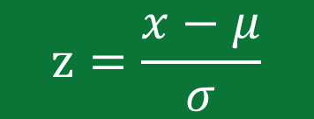


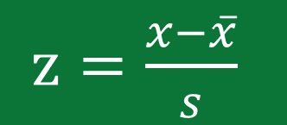

Z-SCORE
The number of standard deviations that a given value x is above or below the mean.
Properties of the z-score:
Used to identify unusual values (>2 or <-2 is ‘unusual’)
Expressed as numbers with no units of measurement
Values less than the mean have negative z-scores
Rounded to 2 decimal places
sample z-score of value $x$
$z=\frac{x−\overline{x}}{s}$
$x$ - mean
population z-score of value $x$
$$z=\frac{x−μ}{σ}$$
standard deviation
Notes:
In the previous video, I talked about standard deviations, and mentioned that for many datasets, 95% of the elements will lie within 2 standard deviations of the mean. Of course, this depends on the shape of our data, but as a general rule we can call any value above or below the mean by two standard deviations ‘unusual’. Those with a high z-score are unusually larger than the mean, and those with a low negative z-score (i.e., -3 or -4) are unusually smaller than the mean.
Calculating the z-score of our data value is very simple – just subtract the mean and divide by the standard deviation, then round it to 2dp. I’ve included the equation for the z-score of a data value in the population, just to show you the difference in units for mean and standard deviation. In the population case, it makes use of Greek letters rather than the more familiar Latin alphabet that we use for the sample equation.

Slide 6

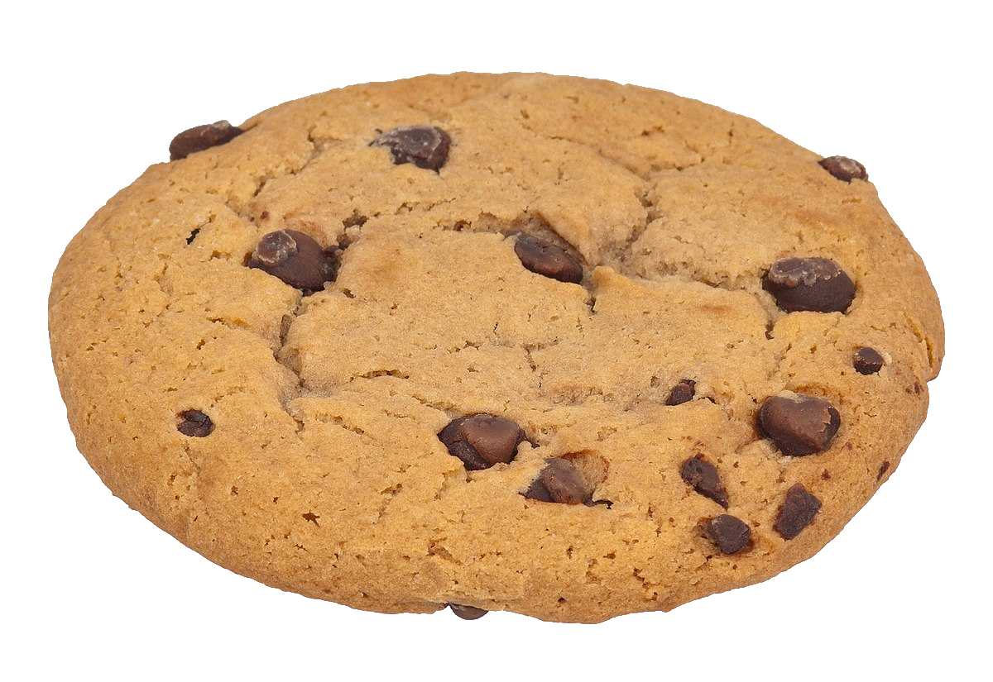
COOKIES OR COKE?
We have two independent samples - one for the number of chocolate chips in cookies, where the mean is 24.1 and the standard deviation is 1.95, and the other one for the weights of Coke cans, where the mean is 0.81672lb and the standard deviation is 0.00751lb.
Which of these is more unusual?
30 chocolate chips
0.8295lb
Notes:
(Worked example in the video)

Slide 7
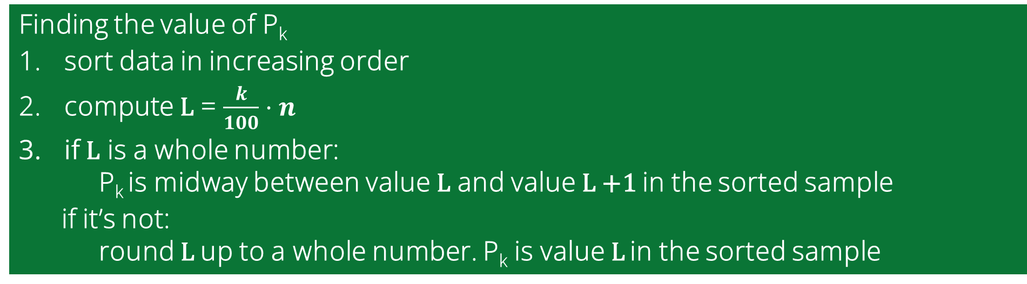

PERCENTILES
Measures of location, denoted P₁, P₂,…, P₉₉, which divide a set of data into 100 groups with about 1% of the values in each group
percentile of value $x$ = $\frac{number of values < x}{total number of values}⋅100$
Finding the value of P_{k}
sort data in increasing order
compute L = $\frac{k}{100}⋅n$
if L is a whole number: P_{k} is midway between value L and value L +1 in the sorted sample
if it’s not: round L up to a whole number. P_{k} is value L in the sorted sample
Notes:
Another way we can represent the location of a value in our data set a certain value is through percentiles. There are 99 of these, which split the data up into 100 different groups.
We say a data value is in, say, the 70th percentile if it is greater than 70% of the rest of the data set.
To find the percentile of a value, we take the number of values that are smaller, divide that by the total number of values, and multiply by 100 to get a percentage.
If we want to find the value that corresponds to a certain percentile, we can sort-of reverse the procedure. So, to find the value of the 70th percentile in our data set of, say, 10 numbers, we’d compute 70/100 * 10, which is 7. Because 7 is a whole number, the value of the 70th percentile is halfway between the 7th and 8th values in our ordered sample.

Slide 8

COOKIE PERCENTILES
Given a sample of chocolate chip counts in cookies:
X = (20, 19, 23, 24, 21, 24, 24, 25, 22, 20, 21, 20),
find the percentile of the cookie with 23 chocolate chips.
Notes:
(Worked example in the video)

Slide 9
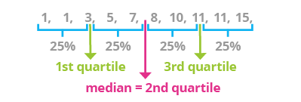
QUARTILES
Measures of location, denoted by Q₁, Q₂ and Q₃ that divide a set of data into four groups, with about 25% of the values in each group
Why are there three quartiles and not 4 (as the name suggests?)
Three quartiles split the dataset into four groups
Q₁=P₂₅, Q₂=P₅₀, Q₃=P₇₅
Notes:
Quartiles are very much like percentiles, except as their name suggests, they split our data up into four groups and not 100. It can seem a bit unintuitive with a name like ‘quartile’ that there are three and not four, but that’s because we only need three to split the data four ways.
The first separates the bottom 25% of our data from the top 75%.
The second separates the bottom 50% from the top 50% (which also makes it our median).
And of course, the third separates the bottom 75% from the top 25% - that is to say, at least 75% of the sorted values are less than or equal to Q3, and at least 25% of the values are greater than or equal to Q3. That means that Q1 is the same as the 25th percentile, Q2 is the same as the 50th percentile, and Q3 is the same as the 75th percentile.

Slide 10
THE 5-NUMBER DATASET SUMMARY
For a dataset, the 5-number summary is:
Minimum value
First Quartile (Q₁)
Second Quartile (Q₂) – also the median!
Third Quartile (Q₃)
Maximum value
From these we can construct boxplots!
Q₁
Q₂
Q₃
min
max
0
10
20
30
40
IQR
60
70
80…
Notes:
The values of our three quartiles, as well as the maximum and minimum values of the dataset, are what’s called a ‘5-number dataset summary’. From these values, we can construct ‘boxplots’. These are a simple graphical representation of the structure of our dataset that shows how it is balanced. Unlike standard deviation or variance, these measures of standing, visually represented, give a clear idea of whether the data is skewed one way or the other.
They are also sometimes called ‘box and whisker’ diagrams, with the box illustrating the three quartiles, and the ‘whiskers’ showing where the min and max values lie.

Slide 11
OUTLIERS (USING QUARTILES!)
Isolated values far away from the dataset mean; can strongly affect values of important statistics (e.g., mean and standard deviation)
Determining if a value is an outlier:
Find the quartiles Q1 and Q3.
Find the interquartile range (IQR) = Q3 − Q1.
Evaluate 1.5 * IQR.
A data value is an outlier if it is either…
above Q3 by an amount > 1.5 * IQR or
below Q1 by an amount > 1.5 * IQR
Notes:
What we call ‘extreme values’ or ‘outliers’ can be difficult to quantify and will vary depending on what your data set is for. However, we can draw ‘modified boxplots’ that do not include these outliers as part of the whiskers, but instead show them as little crosses or dots to demonstrate that they were not included in the original calculations.
To determine an ‘outlier’, we find what’s called the interquartile range by subtracting Q1 from Q3. We then label a data value as an outlier if it’s over Q3 by 1.5 x the IQR, or less than Q1 by 1.5 x the IQR.
Boxplots don’t show as much information as other plot types that we’ll look at in the coming weeks, but they are an excellent way of comparing two different data sets, provided that you plot them on the same scale.

Slide 12
SUMMARY
Measures of centre are used to summarise data using one value
Measures of variation are used to quantify the amount of variation in the values of the dataset
Measures of relative standing are used to show the position of a data value with respect to other values in the set
Using the above measures, we can understand the data and discover any unusual values in a dataset
Notes:
And that’s everything for this week. We’ve covered measures of centre, variation, relative standing, and how to use them to describe a data set. In the introduction video, I also talked about developing ‘statistical thinking’ and why this is just as important as being able to do the calculations. Because if your data has been collected in the wrong way, then it’s not worth analysing, and if you misinterpret your analysis, you might draw the wrong conclusions.
This is especially bad when doing inferential statistics, which we’ll be discussing in Weeks 3 and 4 of the module, but for now it’s still useful to be able to recognise good sampling and analysis.

Slide 13
72nd percentile?
11
23
29
45
62
63
81
88
90
99
72
value 8
x 10
= 7.2
100
P₇₂ = 88
(a decimal number –
round to 8)

